Slide 1
MODELING OBJECT RELATIONSHIPS IN A UNIVERSITY MANAGEMENT SYSTEM
OBJECT-ORIENTED ANALYSIS AND DESIGN (OOAD)
E. SAKTHI PRIYA(192520041)
B.E BIOINFORMATICS

Slide 2
INTRODUCTION
A University Management System (UMS) is a software application that manages academic and administrative activities in a university.
It stores information about students, faculty, departments, and courses.
In Object-Oriented Analysis and Design (OOAD), these entities are represented as objects, and their interactions are modeled using object relationships.
Proper relationship modeling helps build efficient, scalable, and maintainable software systems.

Slide 3
UNIVERSITY MANAGEMENT SYSTEM OBJECTS
Main Objects in the System
The major objects involved in a University Management System are:
Student – Enrolls in courses and maintains academic records.
Faculty – Teaches courses and guides students.
Department – Manages faculty, students, and courses.
Course – Contains subject information and learning materials.
These objects interact with one another through different types of object relationships.

Slide 4
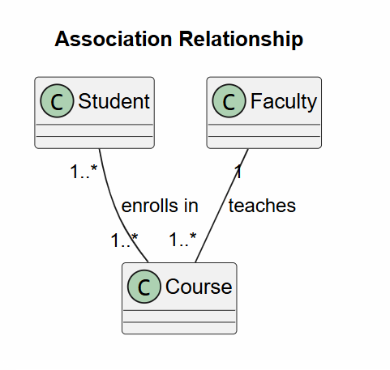
ASSOCIATION RELATIONSHIP
Association
Association is a relationship where two or more objects are connected but can exist independently of each other.
Examples
A student enrolls in one or more courses.
A faculty member teaches one or more courses.
Characteristics
Weak relationship
Objects exist independently
Supports one-to-one, one-to-many, and many-to-many relationships

Slide 5
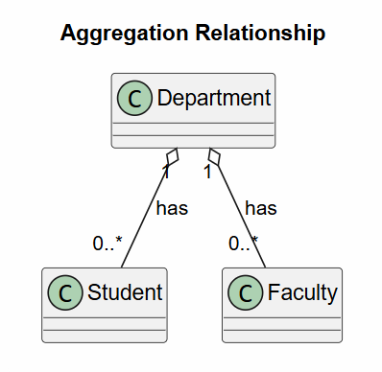
AGGREGATION RELATIONSHIP
Aggregation
Aggregation represents a "Has-A" relationship where the parent object contains child objects, but the child objects can exist independently.
Examples
A department has many faculty members.
A department has many students.
If a department is removed, faculty members and students still exist in the university.
Characteristics
Weak ownership
Child objects have independent life cycles

Slide 6
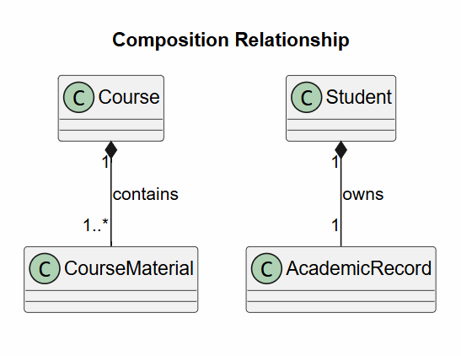
COMPOSITION RELATIONSHIP
Composition
Composition is a strong "Part-Of" relationship where the child object cannot exist without the parent object.
Examples
A course contains course materials.
A student record contains academic history.
If the parent object is deleted, all its child objects are also deleted.
Characteristics
Strong ownership
Same life cycle for parent and child

Slide 7
COMPARISON OF OBJECT RELATIONSHIPS
FEATURE | ASSOCIATION | AGGREGATION | COMPOSITION
RELATIONSHIP | Uses | Has –A | Part-of
OWNERSHIP | No | Weak | Strong
DEPENDENCY | Independent | Partial | Complete
LIFE CYCLE | Separate | Separate | Same
UML SYMBOL | Line | Hollow diamond | Filled diamond

Slide 8
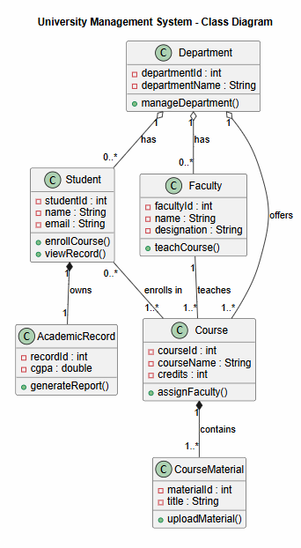
UML CLASS DIAGRAM

Slide 9
BENEFITS OF RELATIONSHIP MODELING
Benefits
Proper object relationship modeling provides several advantages:
Improves system flexibility
Encourages code reusability
Simplifies system maintenance
Reduces redundancy
Makes the software scalable
Improves object interaction

Slide 10
FLEXIBILITY,REUSABILITY & MAINTAINABILITY
Why These Relationships Are Important
Flexibility
New modules can be added easily.
Existing classes require fewer modifications.
Reusability
Classes can be reused in multiple applications.
Reduces duplicate code.
Maintainability
Easier debugging and testing.
Simplifies future updates.

Slide 11
REAL WORLD UNIVERSITY EXAMPLE
Real-World Application
A University Management System uses object relationships to manage daily academic activities.
Students enroll in multiple courses.
Faculty members teach different courses.
Departments manage students and faculty.
Courses contain study materials and assessments.
Student records store academic performance.
These relationships accurately represent real-world university operations.

Slide 12
CONCLUSION
Association, Aggregation, and Composition accurately model relationships between objects in a University Management System.
Proper relationship modeling improves system flexibility, reusability, and maintainability, making the software easier to develop and update.
Using appropriate object relationships reduces complexity and creates a clear, organized system design.
Effective relationship modeling results in a scalable, reliable, and efficient University Management System.

Slide 13
THANK YOU

